Slide 1
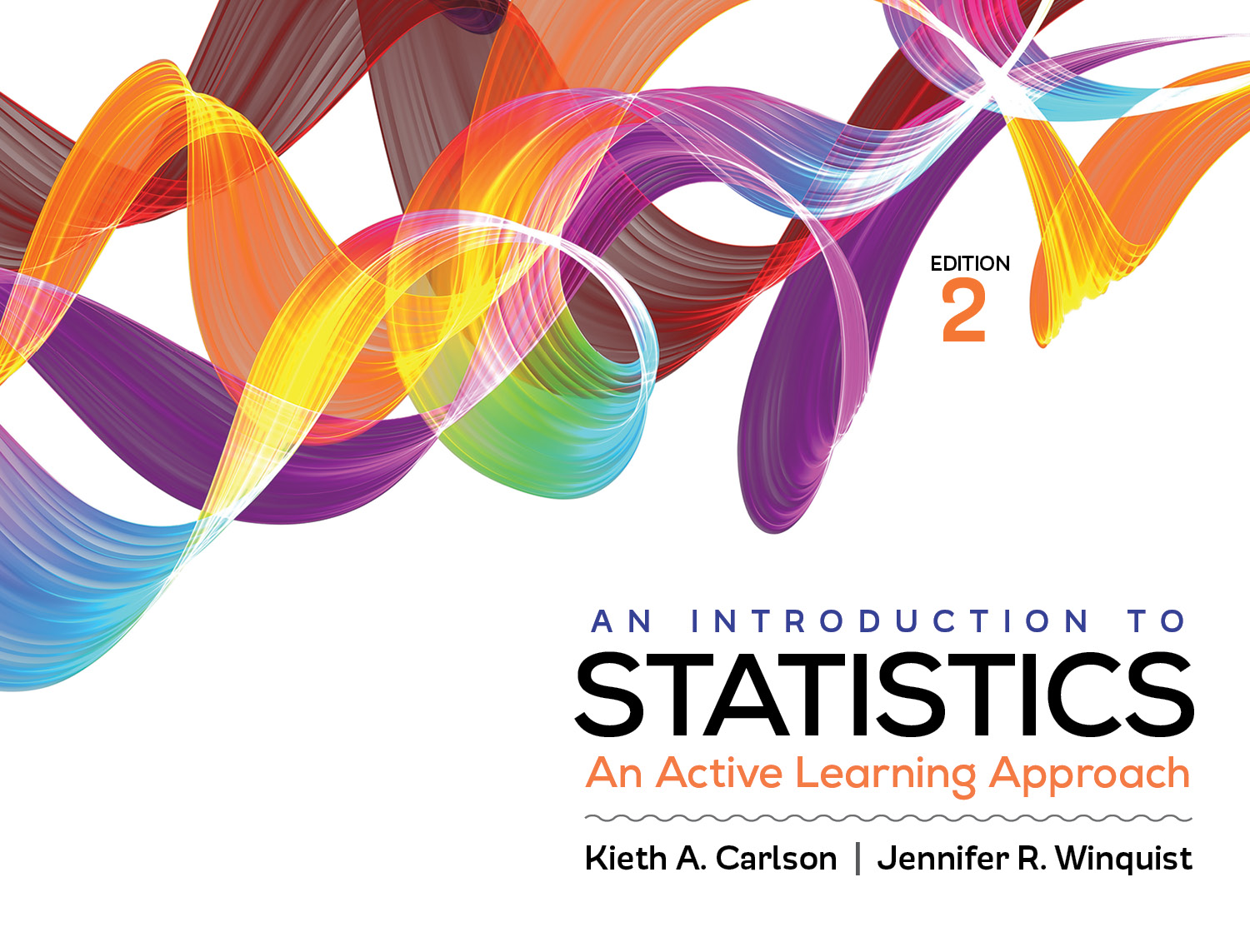
Introduction to Activity 7.1
Single sample t test

Slide 2
Activity 7.1 will require you to:
Explain when to use a single sample t test rather than a z for a sample mean
Conduct all 6 steps of a 1- and 2-tailed hypothesis test using a single sample t test
Do computations by hand and using SPSS

Slide 3
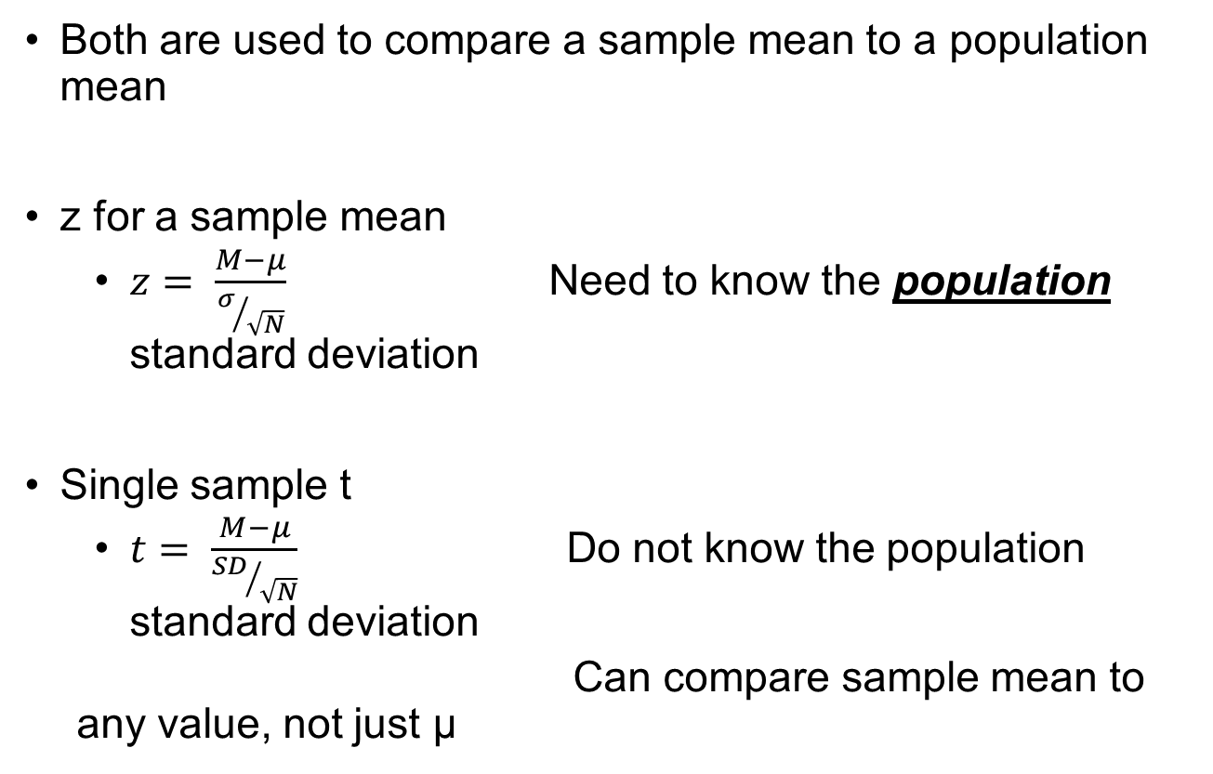
Single sample t vs z for a sample mean
Both are used to compare a sample mean to a population mean
z for a sample mean
$z= \frac{M−μ}{σ/{\sqrt{N}}}$ Need to know the population standard deviation
Single sample t
$t= \frac{M−μ}{{SD}/{\sqrt{N}}}$ Do not know the population standard deviation
Can compare sample mean to any value, not just µ

Slide 4
One-Tailed vs Two-Tailed Tests

Slide 5
One-tailed hypothesis test with a positive critical region:
Researchers want to determine if a new drug will increase peoples’ scores on a memory test
5% of curve

Slide 6
One-tailed hypothesis test with a negative critical region:
Researchers want to determine if a new drug will decrease peoples’ scores on a cholesterol test
5% of curve

Slide 7
Two-tailed hypothesis test with two critical regions:
Researchers want determine how a curricular change will effect students’ level of satisfaction with their college experience. [They do not have any expectation about this; it might increase or decrease satisfaction]
2.5% of curve
2.5% of curve

Slide 8
Sample problem
Researchers want to know if a curricular change will effect students’ college satisfaction. The population mean satisfaction score on a survey of college satisfaction is normally distributed with µ = 12. The survey yields a satisfaction score on an interval scale of measurement. The sample’s mean satisfaction score (M) is 13.5 with a SD = 4. The sample size (N) = 25.
Why must you use a single sample t test to answer this research question? Explain your reasoning.
Why is this a two-tailed test? Explain your reasoning?
Notes:
You don’t know the population standard deviation so you must use the single sample t
The researchers don’t seem to be predicting a specific direction for the effect so a 2-tailed test is appropriate

Slide 9
Step 1: Assumptions
Data independence
Appropriate measurement of IV (nominal group) and DV (interval/ratio)
Normal distribution of sample means
Population has normal shape or sample size greater than 30
Homogeneity of variance
Difficult to assess because you do not know the population standard deviation
Does the treatment influence the variability of the scores?

Slide 10
Step 2: The hypotheses
Null (H₀): µ_{CC} = 12
The curricular change will not influence college satisfaction scores
Research (H₁): µ_{CC} ≠ 12
The curricular change will influence college satisfaction scores

Slide 11

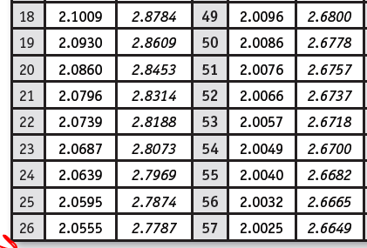
Step 3: Critical region
df = n−1 = 24
Use the two-tailed t table with α = .05.
Reject H₀ if t > or 2.0639 or t < −2.0639

Slide 12
Two-tailed hypothesis test with two critical regions:
Researchers want to determine how a curricular change will effect students’ level of satisfaction with their college experience. [They do not have any expectation about this; it might increase or decrease satisfaction]
Critical region—2.5% of curve
Critical region—2.5% of curve
-2.0639
+2.0639

Slide 13
Step 4: Compute the test statistic
t = (13.5–12)/(4/√25) = 1.875
This is the obtained value, it is NOT in either critical region.
Therefore you do NOT have sufficient evidence to reject the null hypothesis
The 1.5 increase in the sample is likely to be due to sampling error
Should recognize that this conclusion could be a Type II error.
Obtained t value

Slide 14
Step 5: Compute the effect size
d = (13.5−12) / 4 = .375
The treatment (the curriculum change) increased college satisfaction by .375 of a standard deviation; this is a small-medium effect.
This study did not have sufficient statistical power to “find” a small-medium effect

Slide 15
Summarize the results
Those students experiencing the curricular change had college satisfaction scores (M = 13.5, SD = 4) that were not significantly different from the population mean (µ = 12), t (24) = 1.88, p > .05, d = .38. However, the effect size was close to medium in size suggesting that the failure to reject may be the result of the sample size being too small. Further research should be done before firm conclusions can be made.

